Slide 1
Chapter 1: Introduction
Machine Learning Refined: Foundations, Applications, and Algorithms Cambridge University Press (2016)

Slide 2
Predictive modeling: regression
b
a

Slide 3
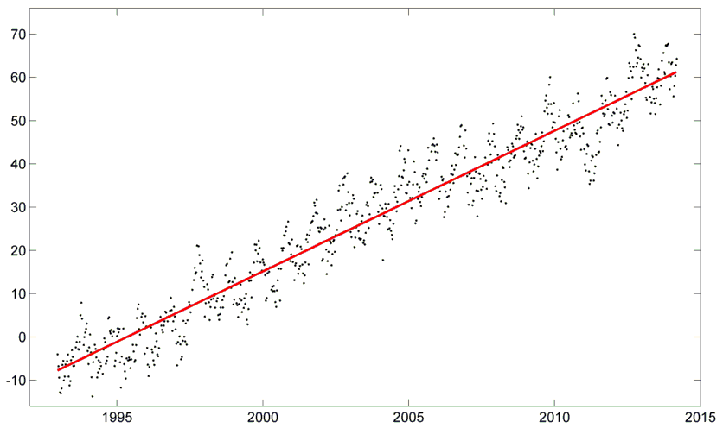
Regression in climate science
sea level rise [mm]
year

Slide 4
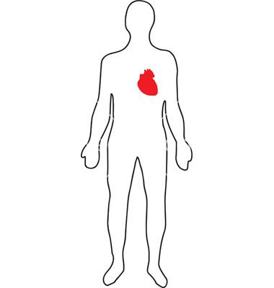
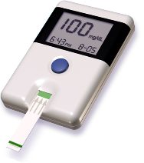
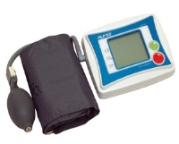
Regression in genetics (How do genes correlate with health factors?)
glucose level
blood pressure
X
1 2 3 4 5 6 7 8 9 10
11
12
13
14
15
16
17
19
20
chromosomes
18
21
22

Slide 5
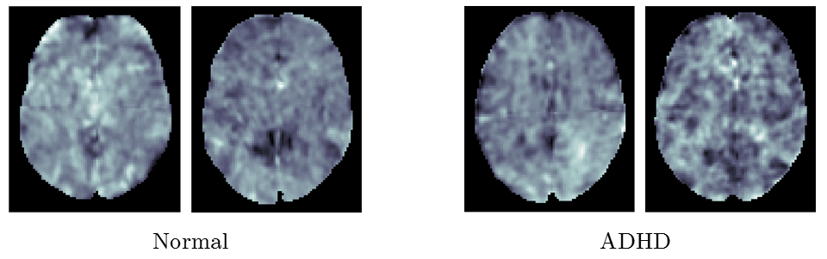
Regression in neuroscience (How does neural activity correlate with specific diseases?)
Normal
ADHD

Slide 6
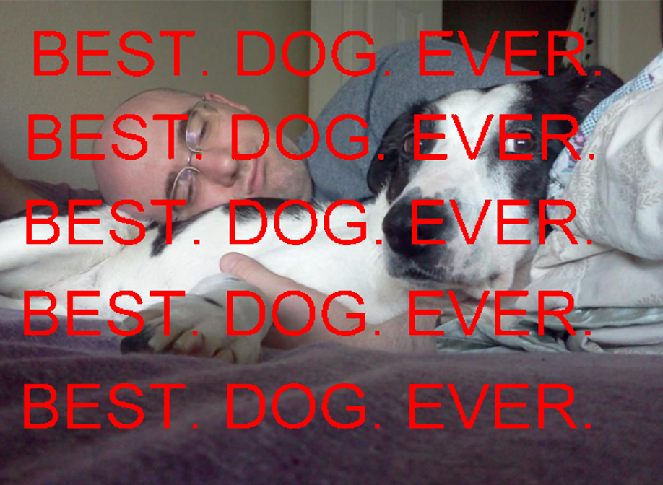
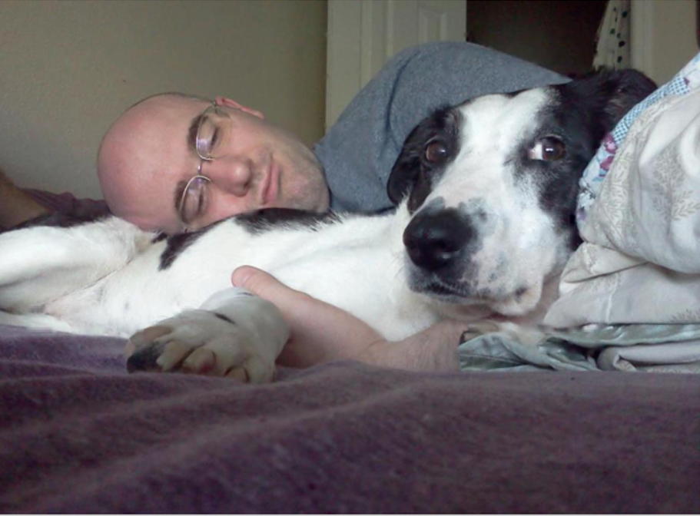
Regression in machine vision

Slide 7
Predictive modeling: classification
feature #2
feature #1

Slide 8

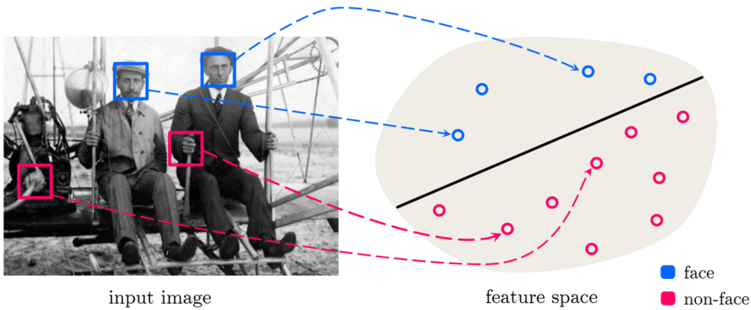
distinguish between different classes of data
Classification
Image taken from [29]

Slide 9
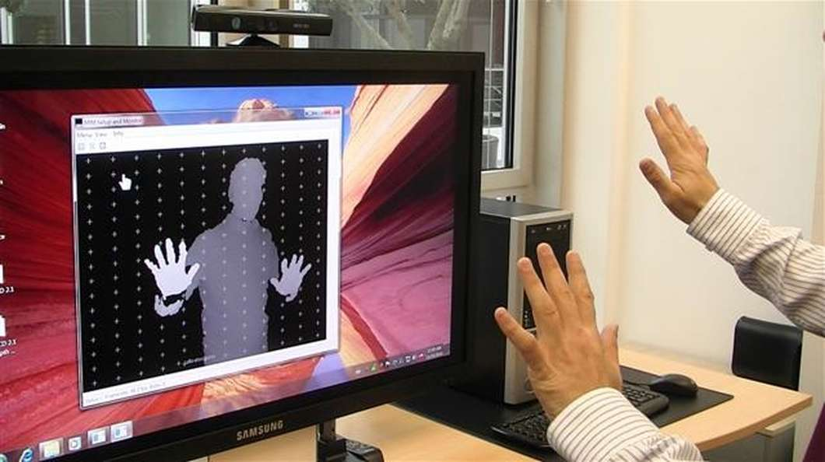
distinguish between different classes of data
Classification
Object detection and recognition:
for human-computer interaction (e.g., [2,9,18,32])
Image taken from http://www.gizmag.com/kinect-used-to-control-windows-7/16997/

Slide 10


distinguish between different classes of data
Classification
Speech recognition:
for human-computer interaction (e.g., [4,7,8,45])
Image taken from (left) http://tiny.cc/n25z8x and (right) www.amazon.com

Slide 11
How does it all work?

Slide 12


Is it a cat or a dog?
vs.

Slide 13
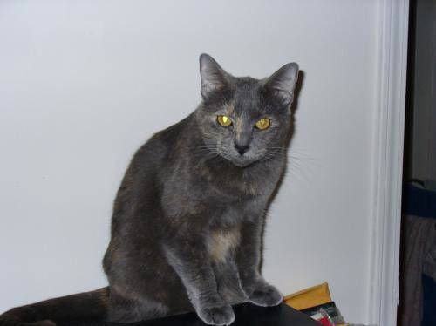
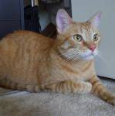
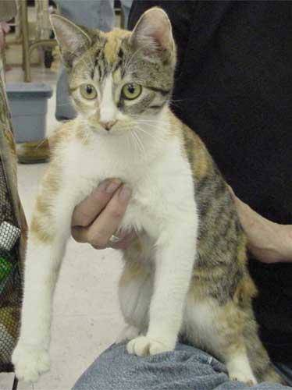
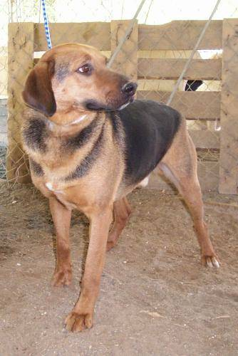
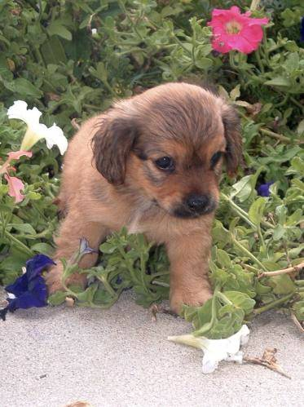
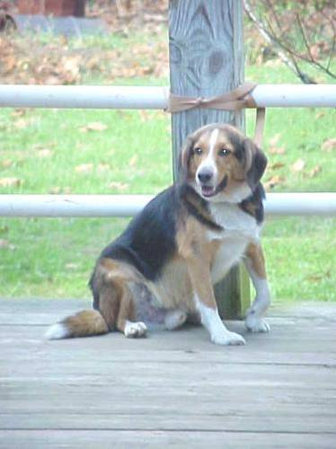
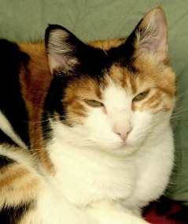
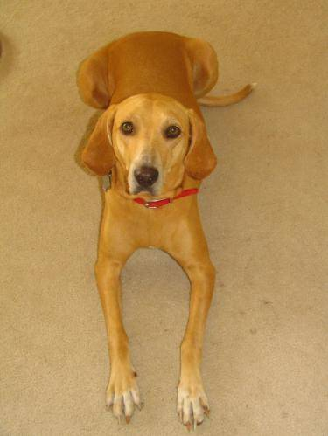
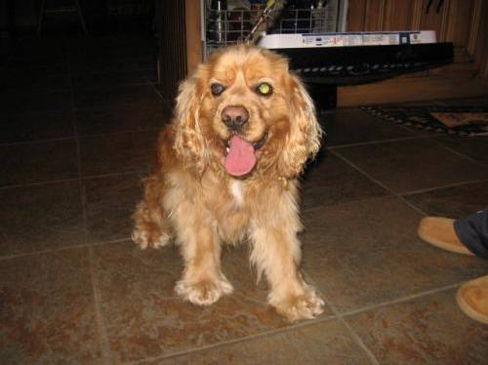
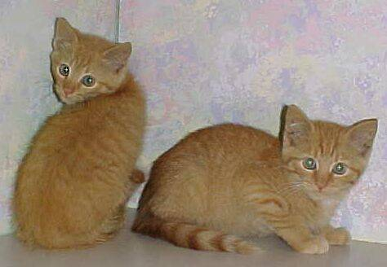
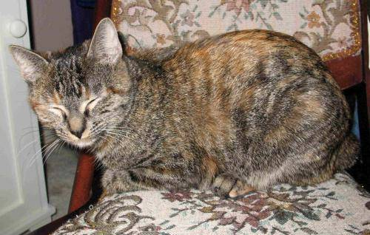
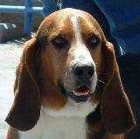
1. Gather data

Slide 14
2. Extract features (tell the computer what to look for)
cats have small noses and pointy ears
dogs have big noses and round ears

Slide 15

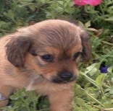
The feature space
each creature is now represented
by two numbers:
(nose size, ear shape)
pointy
ear shape
round
small
nose size
big

Slide 16
3. Choose a geometric model (how the machine will make distinctions)
pointy
ear shape
round
small
nose size
big

Slide 17
4. Train the model (aim for separation between classes – e.g., find the right line)
pointy
ear shape
round
small
nose size
big

Slide 18
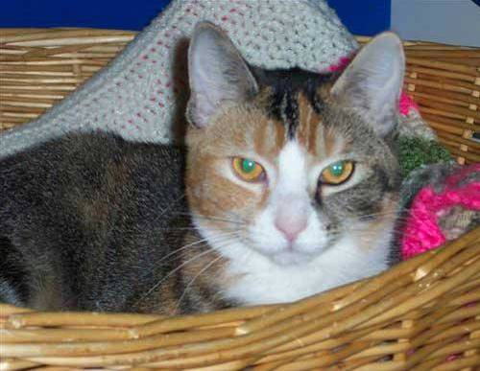
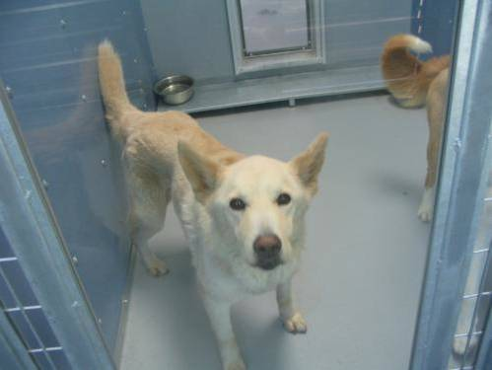
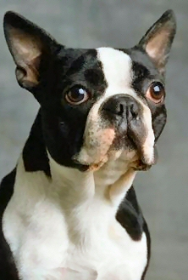
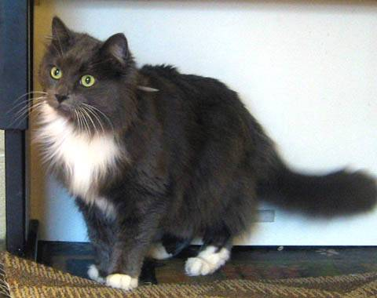
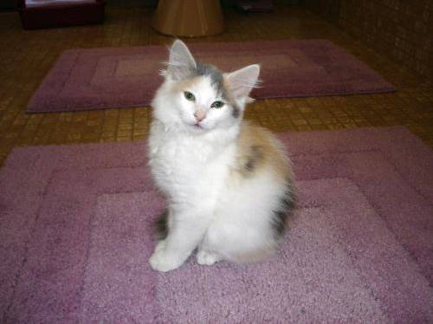
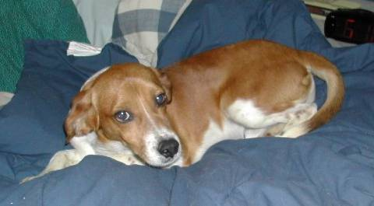
5. Test the model (on new data)

Slide 19

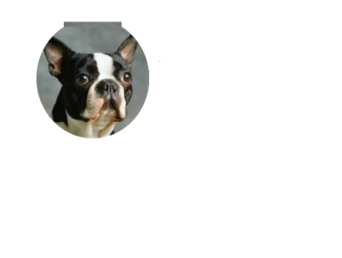
pointy
ear shape
round
small
nose size
big

Slide 20
Learning and optimization

Slide 21
Is it a cat or a dog?
pointy
ear shape
round
How do we train a machine properly?
e.g., how do we find a good separating line?
small
nose size
big

Slide 22
Learning and optimization
Training the model (e.g., finding the right line) requires we optimize an associated cost function
A cost function is a measurement tool that tells us how well the machine performs at a given task given a set of input parameters
The cost function returns a score for each possible set of model parameters e.g., for line fitting there are 2: slope and intercept
The lower the score the better the machine performs, so we aim to minimize these cost functions

Slide 23

pointy
pointy
ear shape
ear shape
round
round
small
nose size
big
small
nose size
big
cost
function
cost
function
intercept
intercept
slope
slope
optimal
slope
optimal
intercept
optimal
slope
optimal
intercept

Slide 24
b
b
a
a
cost
function
cost
function
intercept
intercept
slope
slope
optimal
slope
optimal
intercept
optimal
slope
optimal
intercept

Slide 25
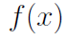
The general shape of cost functions
A convex function (like an upward facing cup or half-pipe)
Almost all predictive models we see have convex cost functions
minimum

Slide 26
The general shape of cost functions
A non convex function (consisting of convex and concave parts)
More complicated, harder to train
But important examples include neural networks and feature learning
minimum
minimum

Slide 27
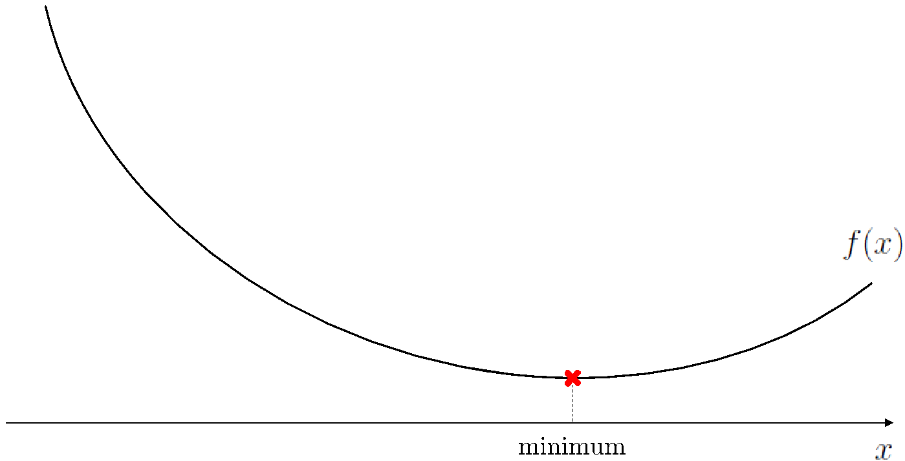
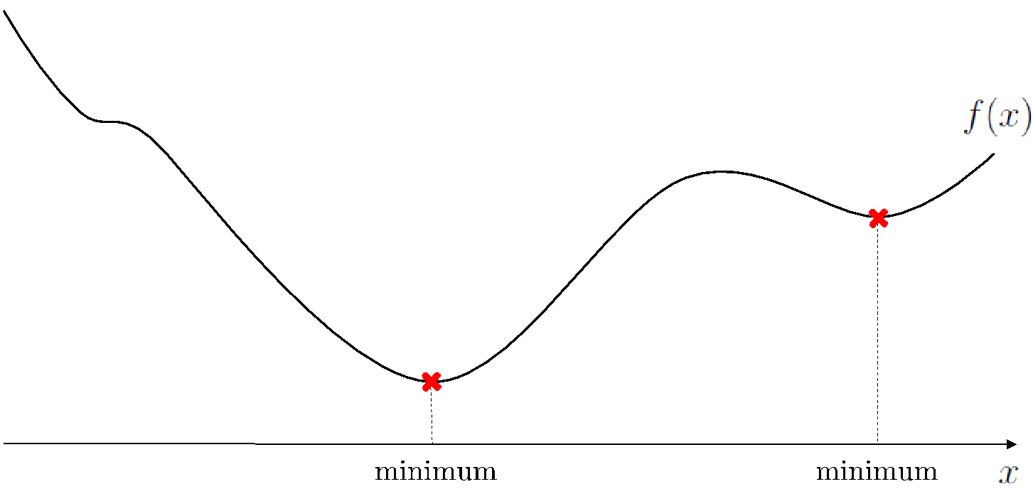
The general shape of cost functions
We will learn how to deal with both flavors
The next few lectures we overview the most basic, but still highly effective, methods to find minima of both

